Slide 1

Criminal Case Analysis
Prepared for City of Chicago
Team Members: Ann Huang, Bill Wang,
Boyuan Wang, Daniel Zhang, Rachel Li

Slide 2

1
Case Background & Objective
2
Data Model
and ETL Process
Agenda
3
Insights for Stakeholders:
Chicago Police Department
4
Insights for Stakeholders:
Citizens of Chicago
5
Limitations & Areas of Improvement
6
Lessons Learned

Slide 3

Part.01
Case Background and Objective

Slide 4

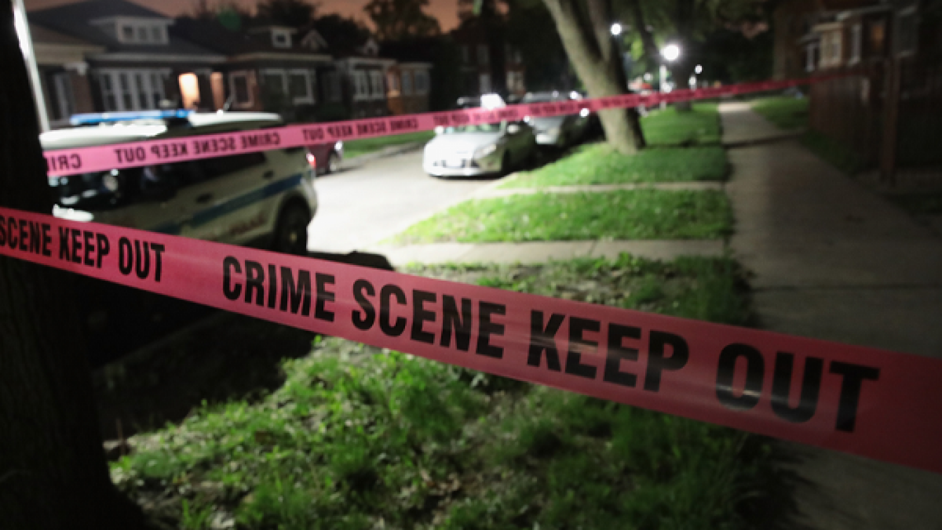
Case Background and Objectives
Chicago Criminal Case Analysis
Background
Chicago's overall crime rate is higher than the US average
Major rise in violent crime starting in the late 1960s
Chicago is considered one of the most gang-infested cities in the US
Objectives
Find out how crime has changed over the years
Help Chicago Police Department and citizens to know the crime case distributions
Increase safety across the city

Slide 5



Major Stakeholders of the Analysis
Chicago Criminal Case Analysis
Chicago Police Department(CPD)
Estate Companies
Results will allow CPD to reference the crime patterns and reallocate the police force to better protect the people.
Help estate companies better set the rates based on the dangerous level of the neighborhood
Chicago Citizens
Reminds citizens which community areas are dangerous in which time periods
Reminds citizens of the high-frequency crime types recently

Slide 6
Part.02
Data Model and ETL Process

Slide 7


Data Source
Data Cleaning
1
Remove "Case Number"
2
Parse "Date"
3
Remove "X Coordinate" and " Y Coordinate"
4
Remove "Ward"
Notes:
Rachel

Slide 8



ETL Process
Chicago Crime Case Analysis
Remove non-necessary columns
Optimize columns for use
Normalization: divide the original excel file into several tables, each with a unique id
After the transformation, load data into MySQL Workbench using command line
Extract
Transform
Load
Transform
Notes:
Rachel

Slide 9
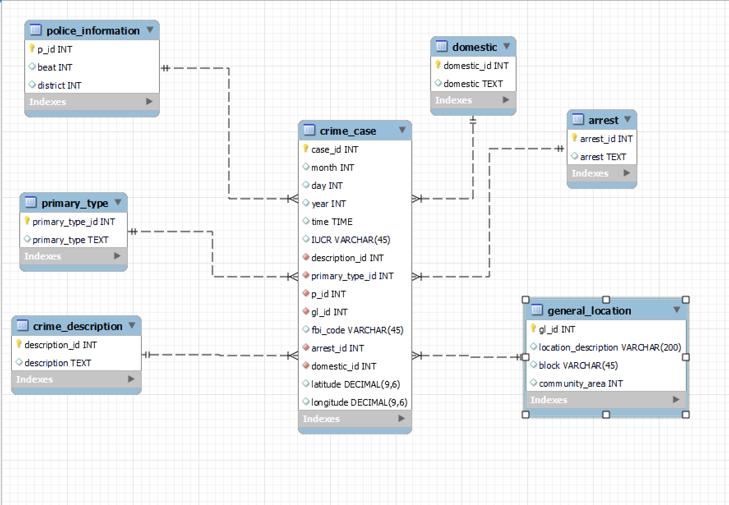
ER Diagram
Chicago Criminal Case Analysis
Notes:
Rachel

Slide 10
Part.03
Insights for Chicago Police Department

Slide 11
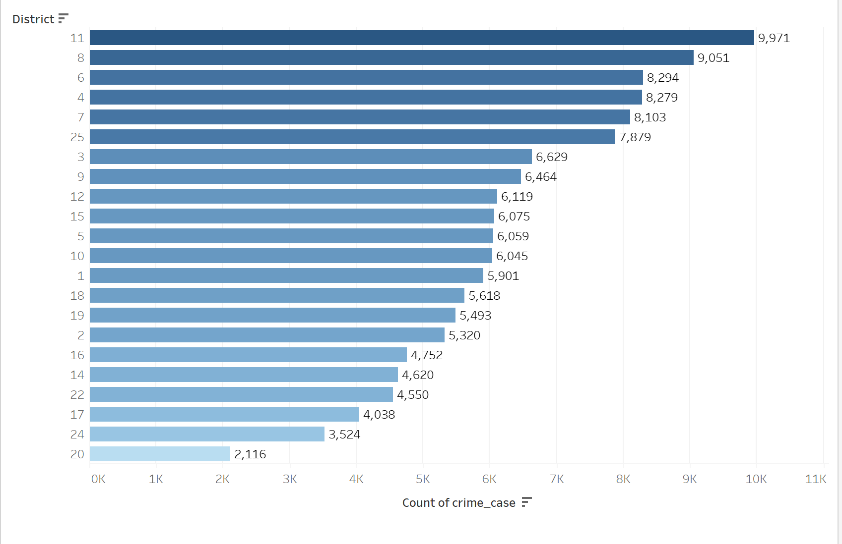
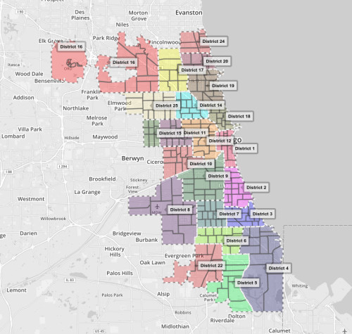
Crime Count Group by District
Chicago Criminal Case Analysis
Categorized based on police district
11,8,6,4 are the districts with most crimes

Slide 12
Part.04
Insights for Citizens of Chicago

Slide 13
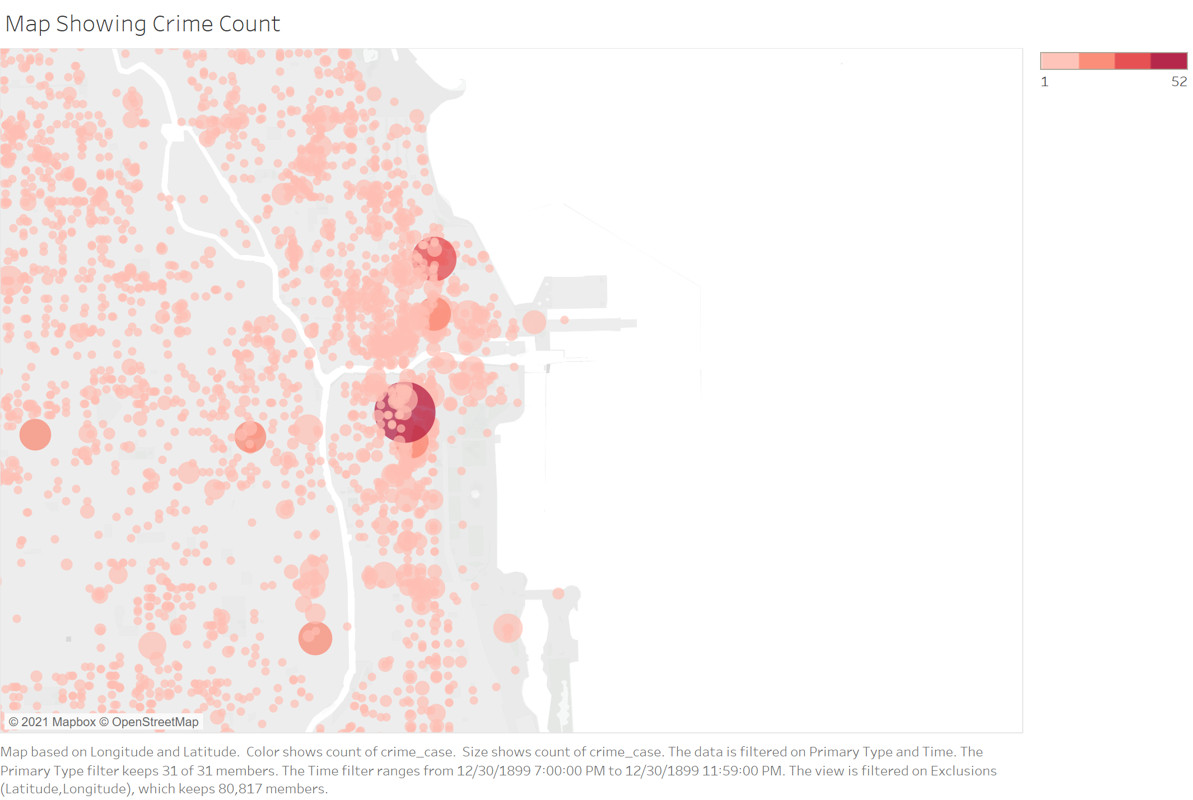
Night-Time Crime Distribution
Chicago Criminal Case Analysis
Crime distribution after 7PM
Dots represent the locations (blocks) of the cases
Sizes and colors of dots represent number of crime cases

Slide 14
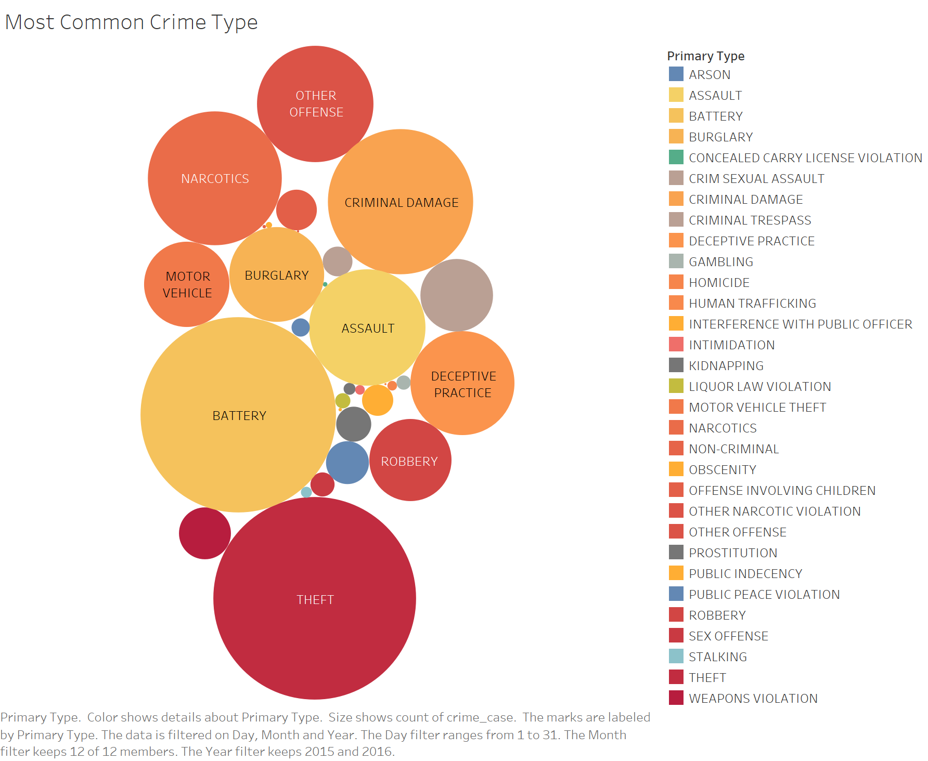
Crime Types Count
Chicago Criminal Case Analysis
Count of different crime types over the year
Size of circles represent the total number of each crime type
Theft, battery, narcotics, and criminal damage are the most common types of crime

Slide 15
Part.05
Limitations &
Areas of Improvement
Notes:
Ann

Slide 16


Limitations
Chicago Criminal Case Analysis
Crime Prediction
Dataset Size
Data Visualization
Constructive Tool
If given more time and high-quality data, our team can develop a model to predict when a certain crime will take place
Crime data starts from 2015 to 2016, with more years of data, our team can provide more accurate results
Geographical data (districts, beats) are difficult to be visualized on map
Lack of constructive systems/websites for residential recommendations
Notes:
Ann

Slide 17
Part.06
Lessons Learned
Notes:
Ann

Slide 18




Lessons Learned
Chicago Criminal Case Analysis
Get hands on experience on importing data into MySQL Command Line
Understand variables before putting data into MySQL
Think on user's perspective to perform data visualization
Use MySQL and Tableau for data storage, database design, and data visualization
Notes:
Ann

Slide 19
Thank You!
Q&A
Notes:
Ann

